Slide 1



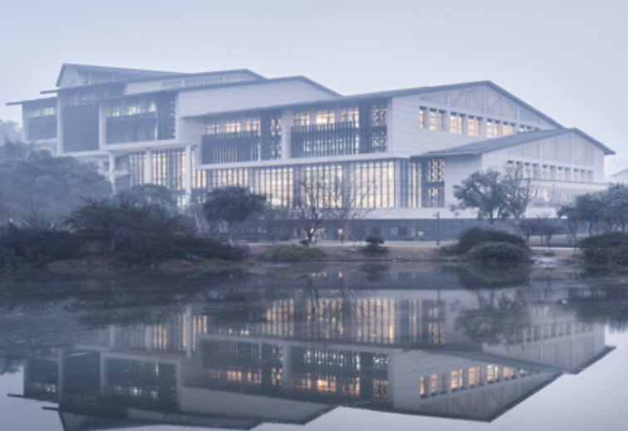





Chongqing University of Technology
ATAI
Advanced Technique of Artificial Intelligence
Chongqing University of Technology
强化学习工作进展
Hongyang Song
Notes:
songhongyang

Slide 2
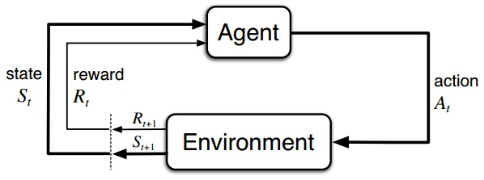
强化学习
Agent: 学习的主体
Action: Agent根据观察环境,得到的可以执行的操作
State: Agent所能感知的环境的状态
Reward: Environment返回的奖励
Policy: Agent根据策略选择执行的Action

Slide 3
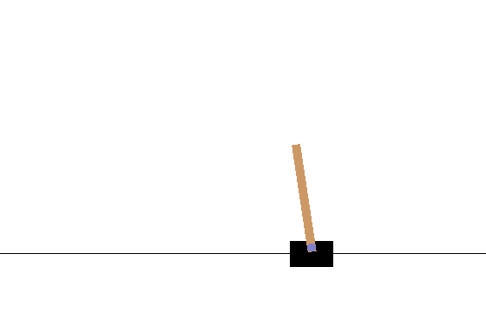
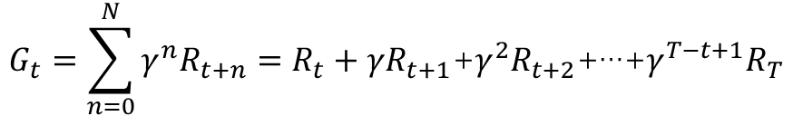
强化学习
CartPole-v0 : openAI gym用于开发和比较强化学习算法的工具包
通过调用其接口,可以得到小车所处的状态和木棍的倾斜程度, 用以判断是否结束游戏
可以看一个游戏的例子进行理解
Agent: 黑色小车
Environment: 整个游戏是所处的环境
Action: 左移(left)和右移(right)
State: 小车所处的位置,小车上的木棍的倾斜角度
Reward: 游戏持续时间
Policy: 对Action进行决策
$$G_{t}=\sum_{n=0}^{N}{γ^{n}R_{t+n}}=R_{t}+{γR}_{t+1}\text{+}γ^{2}R_{t+2}\text{+…+}γ^{T−t+1}R_{T}$$
折扣奖励:
State value function: ${ V}_{π}\left(s\right)=E_{π}[G_{t}|S_{t}=s]$
Action value function: ${ Q}_{π}\left(s,a\right)=E_{π}[G_{t}|S_{t}=s,A_{t}=a]$

Slide 4
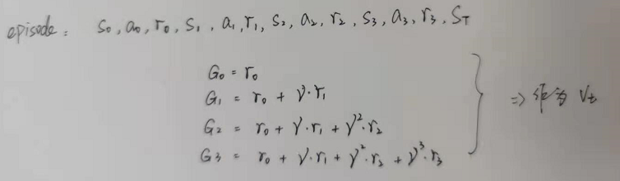
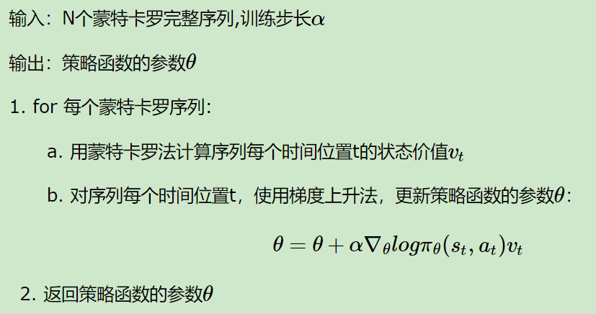
强化学习 Policy Gradient:
Notes:
是按抽样调查法求取统计值来推定未知特性量的计算方法

Slide 5
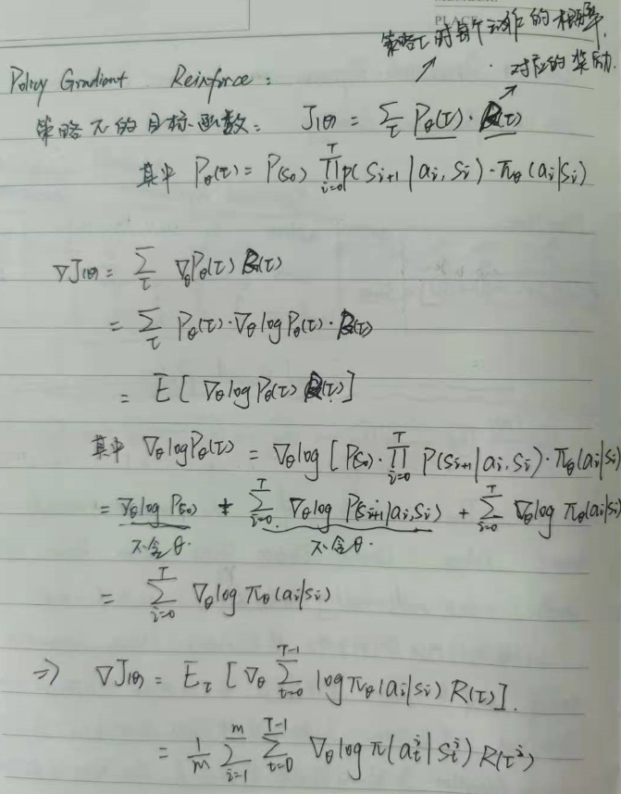
强化学习 Policy Gradient:

Slide 6
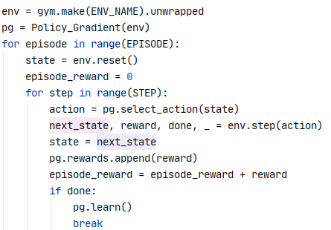
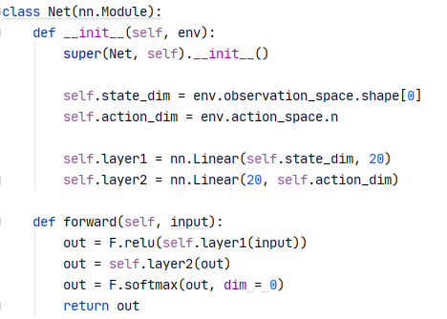
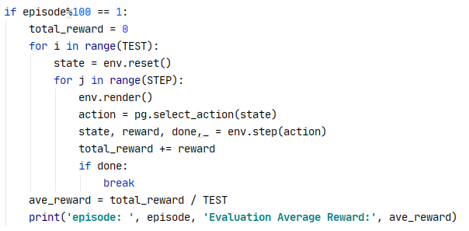
强化学习 Policy Gradient:

Slide 7
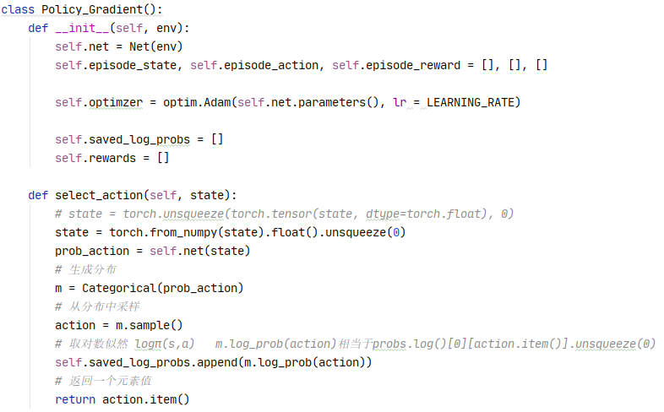
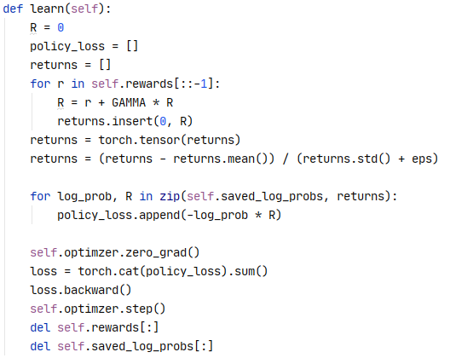
强化学习 Policy Gradient:

Slide 8
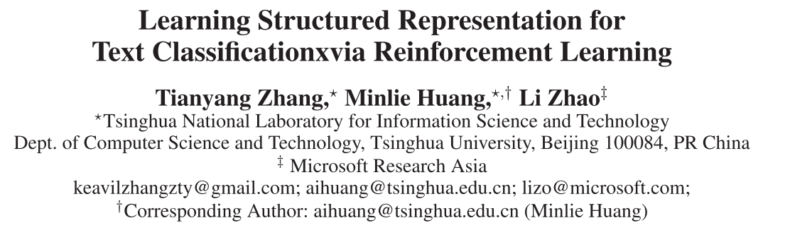
AAAI_2018
Tensorflow: https://github.com/keavil/AAAI18-code
Notes:
AAAI_2018

Slide 9
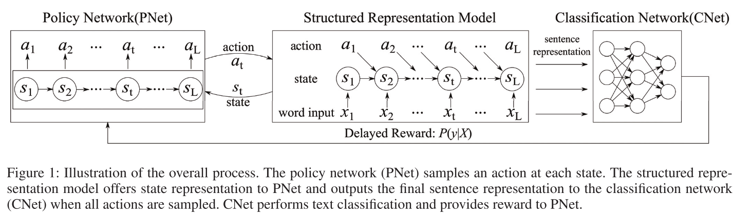
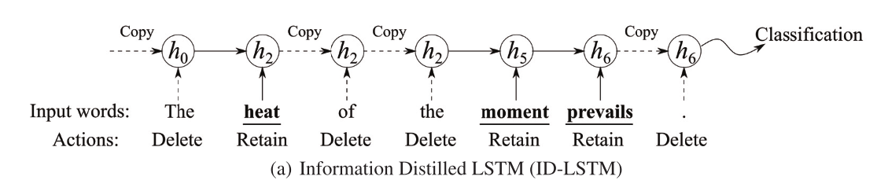

Slide 10
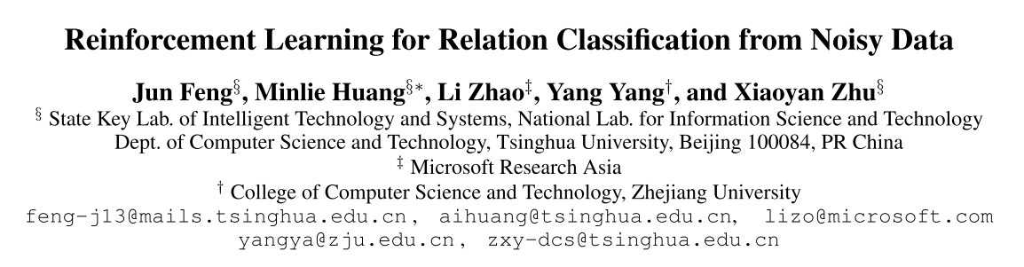
AAAI_2018
Tensorflow: https://github.com/xuyanfu/TensorFlow_RLRE
Pytorch: https://github.com/Molin-L/RLRC

Slide 11
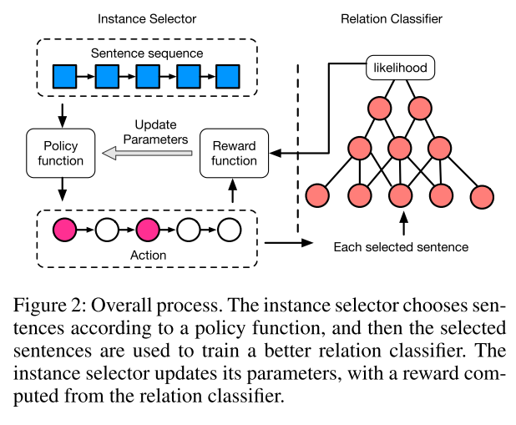

Slide 12
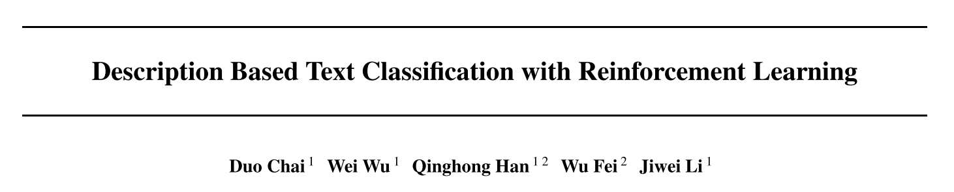
ICML_2020
Notes:
ICML_2020

Slide 13
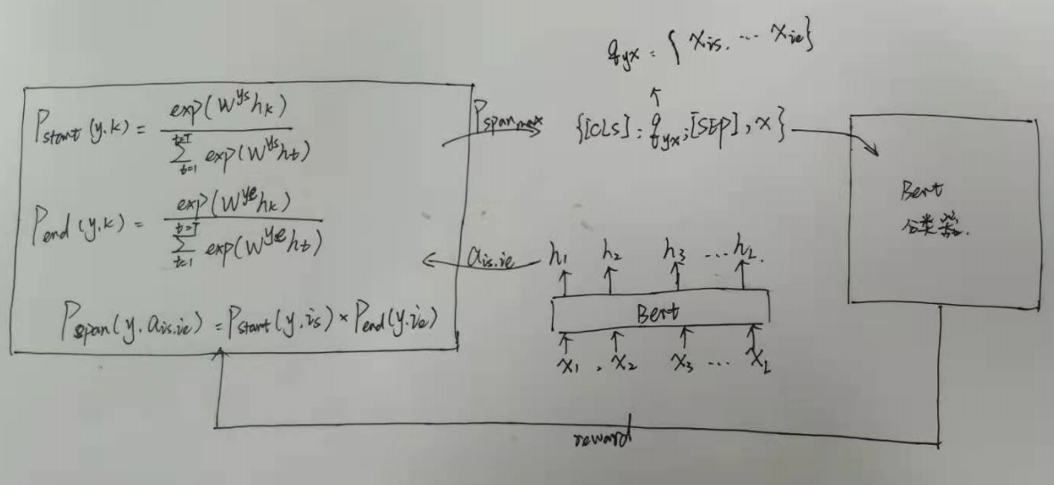

Slide 14
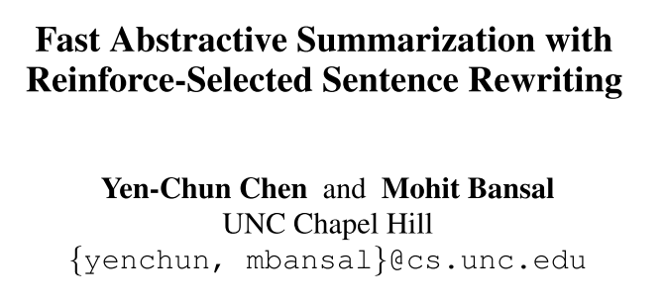
ACL_2018
https://github.com/ChenRocks/fast_abs_rl
Notes:
ACL_2018

Slide 15
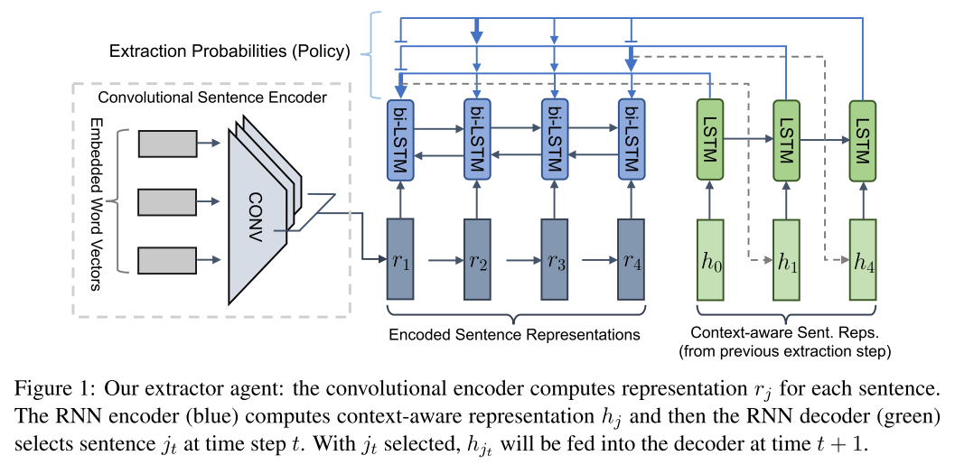
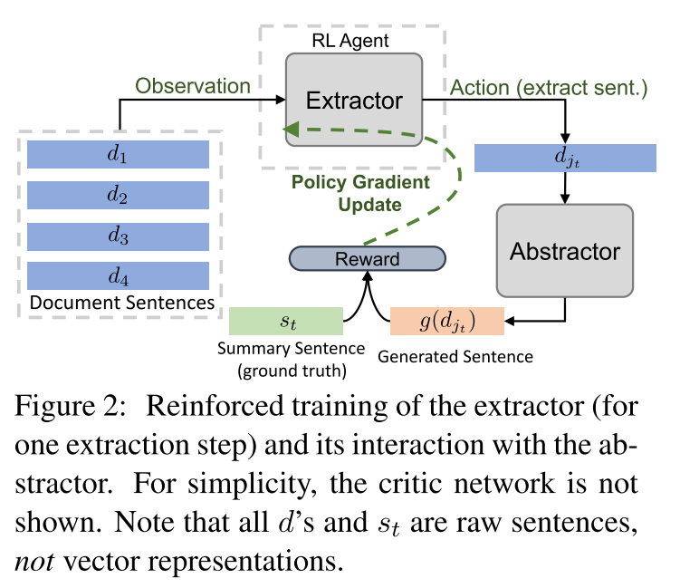

Slide 16
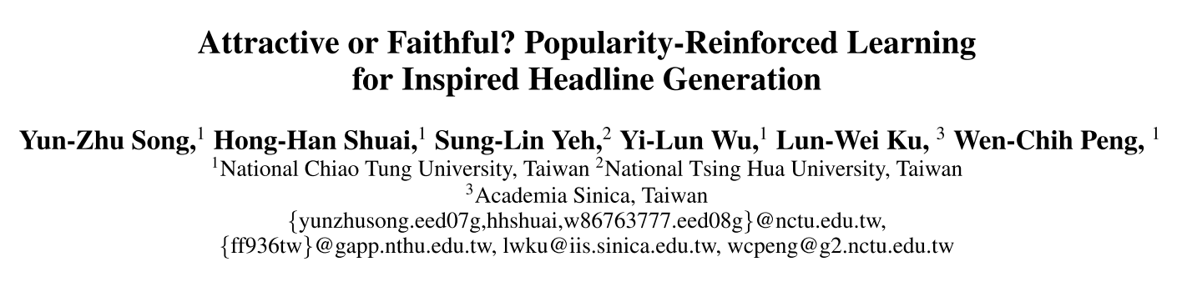
AAAI_2020
https://github.com/yunzhusong/AAAI20-PORLHG

Slide 17
文本分类
ACL_2020_Label-guided Learning for Text Classification
ACL_2020_Contextualized Weak Supervision for Text Classification
SIGIR_2020_A Unified Dual-view Model for Review Summarization and Sentiment Classification with Inconsistency Loss
机器翻译
NAACL_2019_Reinforcement Learning based Curriculum Optimization for Neural Machine Translation
EMNLP_2020_Dynamic Context Selection for Document-level Neural Machine Translation via Reinforcement Learning
推荐
SIGIR_2020_Interactive Recommender System via Knowledge graph-enhance reinforcement learning
Notes:
推荐

Slide 18
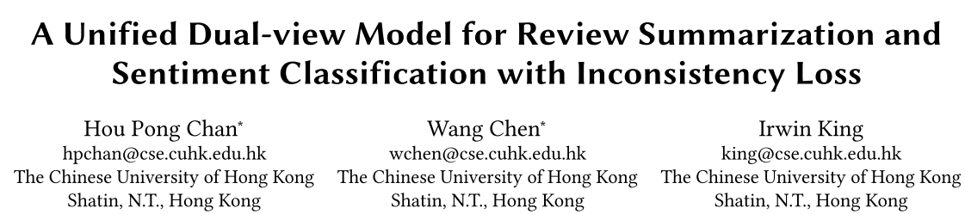
SIGIR_2020
https://github.com/kenchan0226/dual_view_review_sum
Notes:
推荐

Slide 19
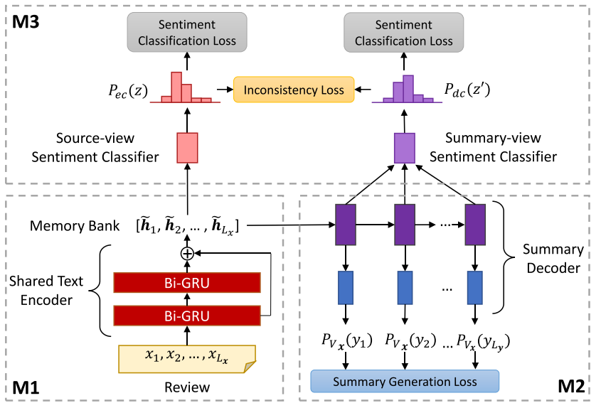
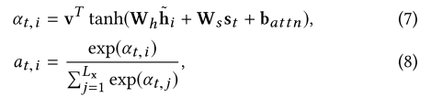

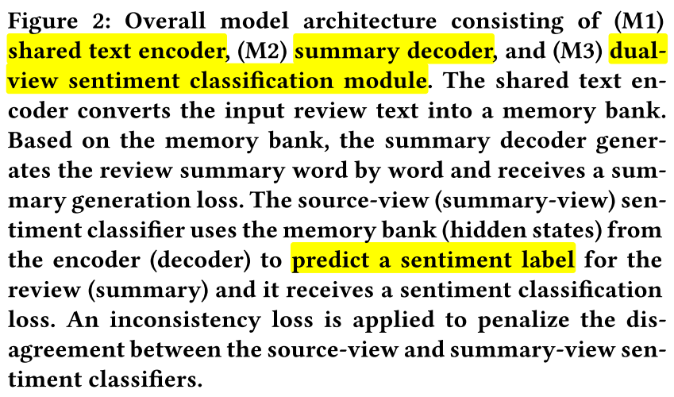

Slide 20
Thanks

